Slide 1
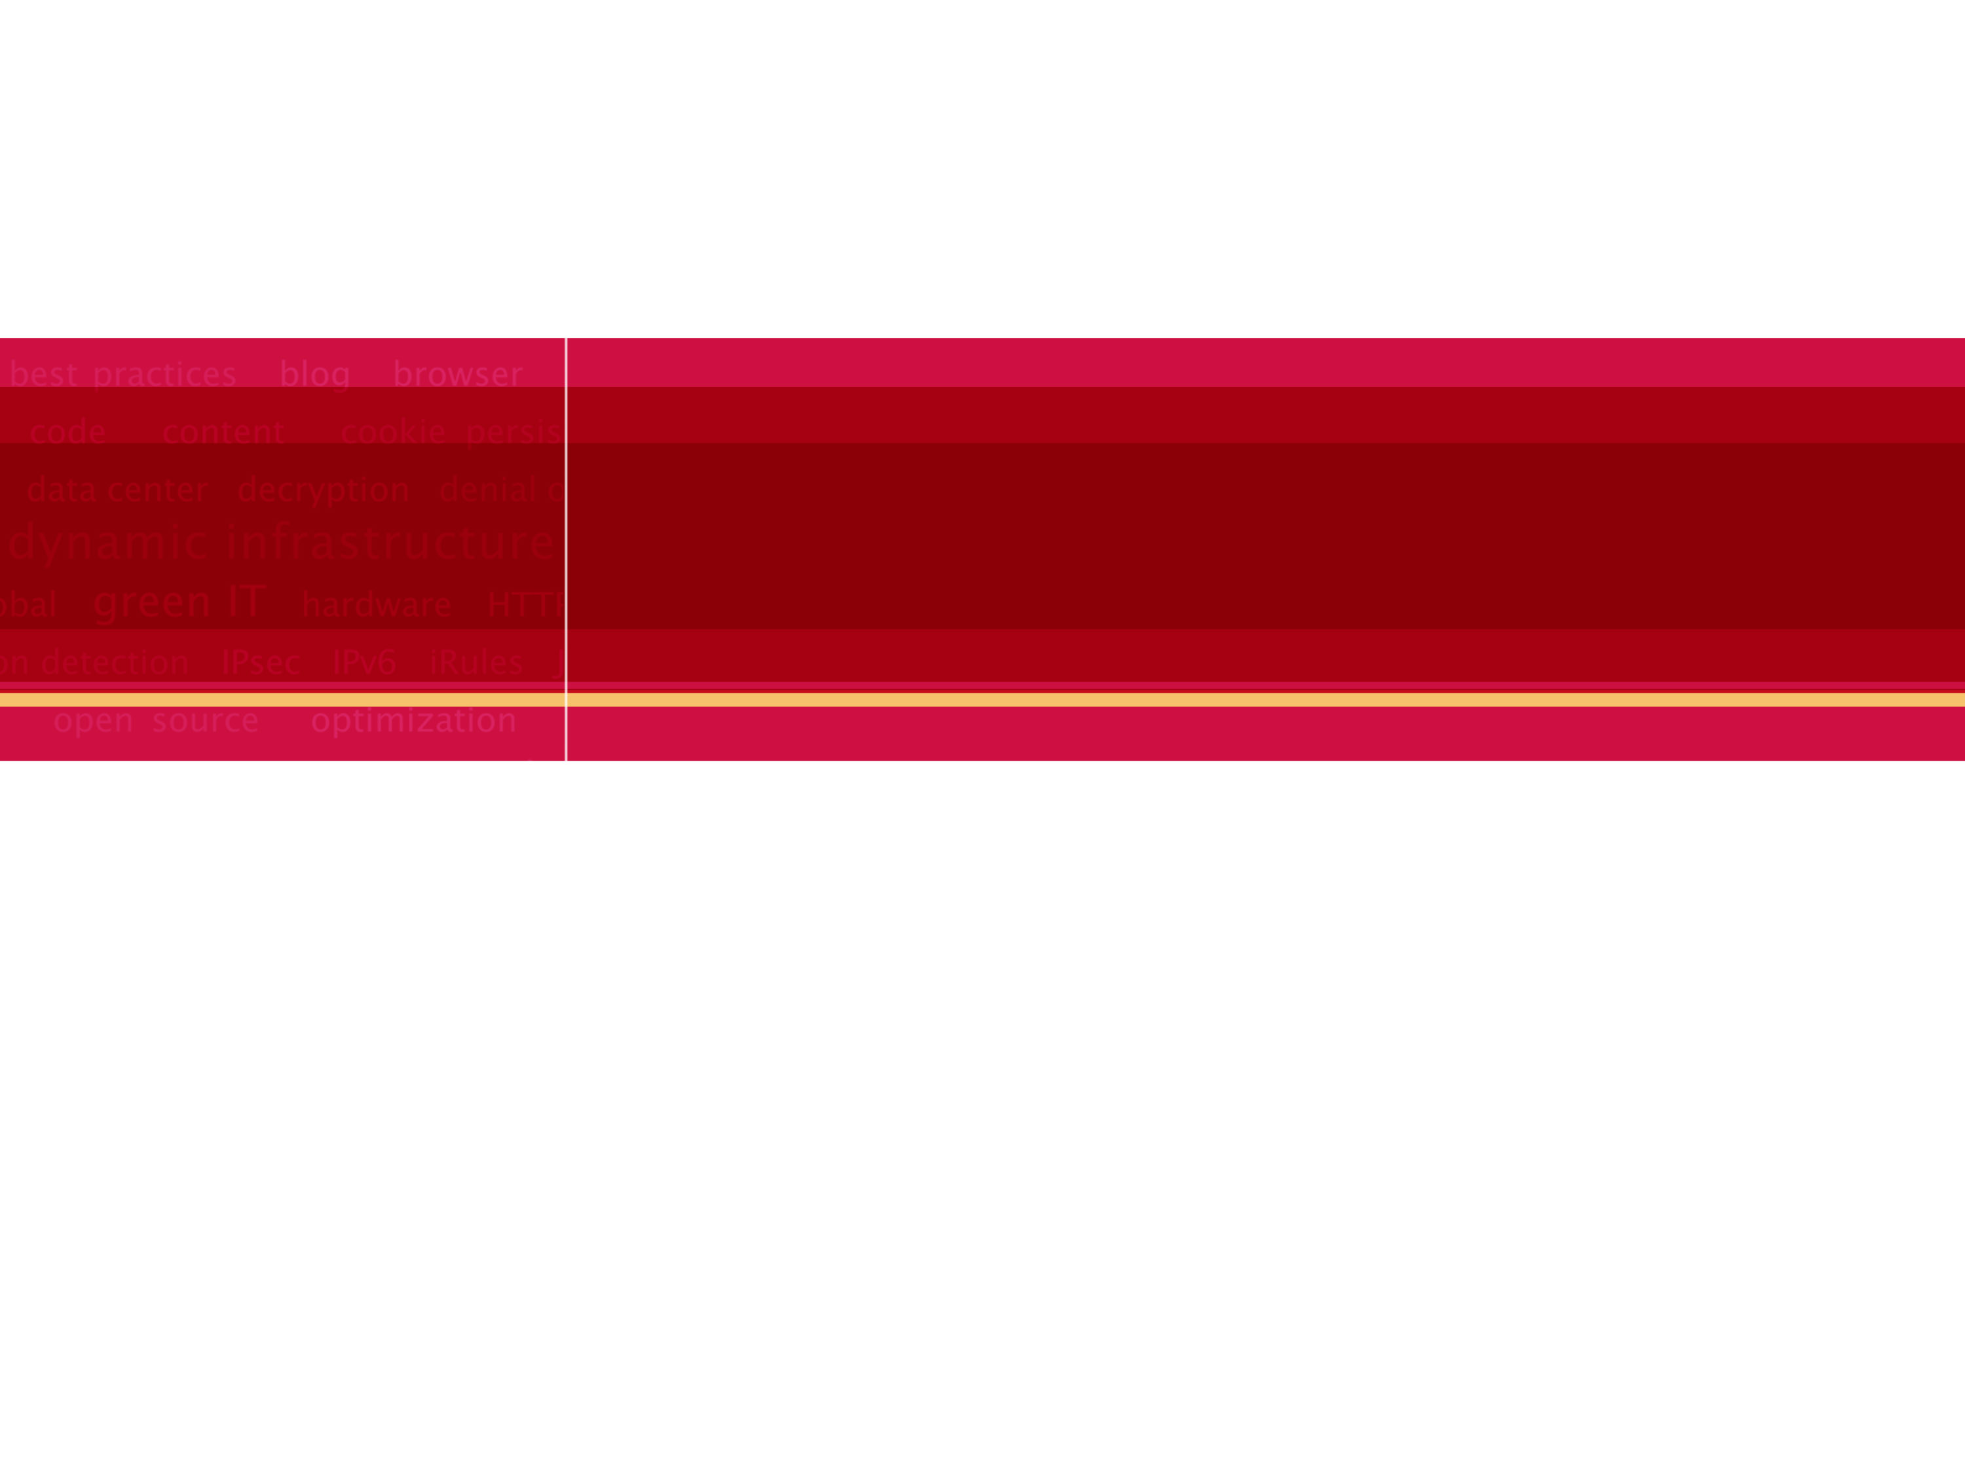

F5-应用交付专家

Slide 2
到底什么是应用交付！
服务器性能提高了至少10倍
网络性能提高了至少5倍
应用性能提高了仅有1倍
用户体验效果依然不佳
应用交付是提高应用性能，应用稳定性，应
用安全性及用户体验的单独且必要领域！！

Slide 3



当今的IT现状
用户体验
商业信息
快速
高可用
安全

Slide 4
当今的IT现状
用户体验
服务器
应用
门户
数据中心
ISPs
客户端
商业信息
快速
高可用
安全

Slide 5
当今的IT系统低效率
用户体验
服务器
应用
门户
数据中心
ISPs
客户端
商业信息

Slide 6
F5如何面对这些问题？
LTM
用户体验
服务器
应用
门户
数据中心
ISPs
客户端
商业信息
访问

Slide 7
F5如何面对这些问题
LTM
LTM
用户体验
服务器
应用
门户
数据中心
ISPs
客户端
商业信息
访问

Slide 8
F5如何面对这些问题
LTM
LTM
WA
用户体验
服务器
应用
门户
数据中心
ISPs
客户端
商业信息
ASM
访问

Slide 9
F5如何面对这些问题
LTM
LTM
WA
WA
GTM
用户体验
服务器
应用
门户
数据中心
ISPs
客户端
商业信息
ASM
WOM
访问

Slide 10
F5如何面对这些问题
LTM
LTM
WA
WA
GTM
LC
用户体验
服务器
应用
门户
数据中心
ISPs
客户端
商业信息
ASM
WOM
访问

Slide 11
F5如何面对这些问题
LTM
LTM
WA
WA
GTM
LC
APM
用户体验
服务器
应用
门户
数据中心
ISPs
客户端
商业信息
ASM
WOM
EDGE
访问

Slide 12





F5：一体化的应用交付架构
International
Data Center
Enterprise Manager /
ControlPoint
Applications & Storage
Users
BIG-IP Link
Controller
BIG-IP Local
Traffic
Manager
ARX
File/Data Virtualization
BIG-IP Global Traffic Manager
BIG-IP Application
Security
Manager
APM
SSL VPN
WOM
BIG-IP Web
Accelerator
iControl
一个整合的硬件平台
统一的管理界面
License功能实现
统一的支持体系
TMOS
99.999%的应用高可用
应用级安全
服务器资源恢复80%
带宽节约2~5倍
Web应用的速度3~7倍

Slide 13
F5作为ADN（应用交付网络）业界的领导者 为用户提供优秀的解决方案
应用交付网络的价值
提高客户响应速度3－10倍
恢复 80% 服务器资源
降低带宽75％以上
实现应用级的安全
数据中心99.999%的高可用性

Slide 14

F5 简介
全球应用交付(ADN)的领导者
总部在西雅图,Nasdq上市(FFIV)
全球应用交付控制器产品市场中占据61%的市场份额
您只要访问互联网一定会经过F5
几乎所有的在线业务,包括银行,税务,证券,电子商务,电子政务…均要经过F5
Notes:
14
14
F5 1.81B EPS +0.95
Radware 104M EPS -1.6

Slide 15
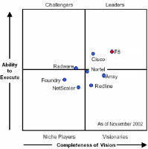
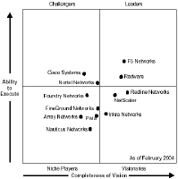
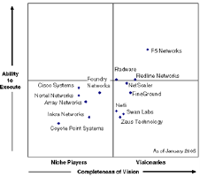
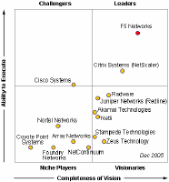
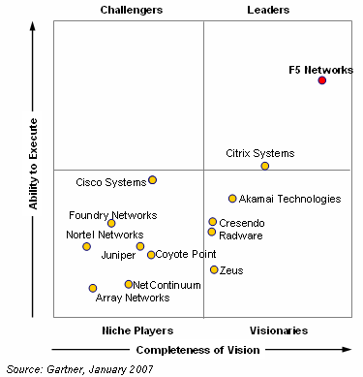
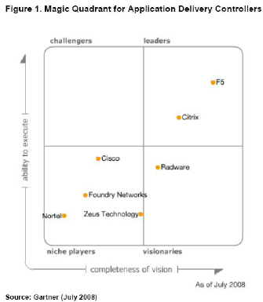
多年的市场变化和F5持续领先的地位

Slide 16














F5中国大客户

Slide 17
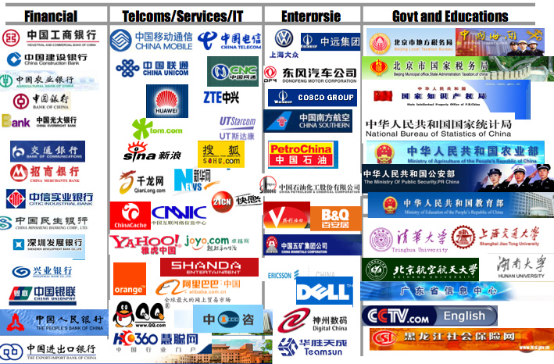
F5中国大客户

Slide 18
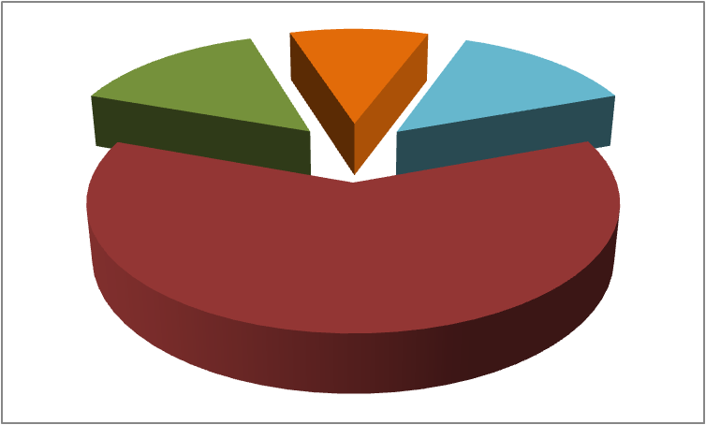


F5 Dominates in Advanced Platform ADC Segment for CY Q110
Q110 Gartner Advanced Platform ADC Market Share
Q110 Advanced Platform ADC* Market Share Leaders
F5: 61%
Citrix: 14.7%
Radware: 10.5%
Q110 Advanced Platform ADC Market Share Revenue Leaders
F5: $126.4 Million
Citrix: $30.4 Million
Radware: $21.7 Million
Q110 Advanced Platform ADC Q/Q Revenue Growth
F5: 12.5%
Citrix: -15%
Radware: 2.4%
Q110 Advanced Platform ADC Total Market Numbers
Revenue: $207.1 Million
Q/Q Revenue Growth: 4.3%
*Advanced Platform Segment Includes: ADCs that integrate several functions (typically more than four) on a single platform (for example, load balancing, TCP, connection management, SSL offload, compression and caching)
Radware
10.5%
Others
13.8%
Citrix
14.7%
F5 NETWORKS
61%
SOURCE: Gartner

Slide 19










F5 解决方案合作伙伴：不是简单堆砌，而是深层互动

Slide 20
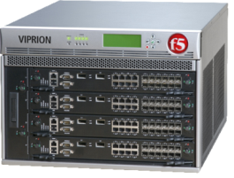
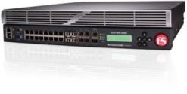
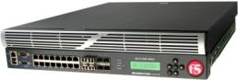
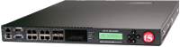
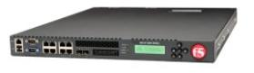
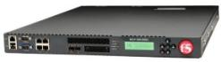
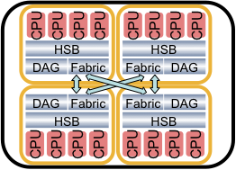
BIG-IP 平台系列
Price
BIG-IP 8900
VIPRION
BIG-IP 6900
2 x Quad core CPU
16 10/100/1000 + 8x 1GB SFP
2x 320 GB HD (S/W RAID) + 8GB CF
16 GB memory
SSL @ 58K TPS / 9.6Gb bulk
6 Gbps max hardware compression
12 Gbps Traffic
Multiple Product Modules
BIG-IP 3900
2 x Dual core CPU
16 10/100/1000 + 8x 1GB SFP
2x 320 GB HD (S/W RAID) + 8GB CF
8 GB memory
SSL @ 25K TPS / 4 Gb bulk
5 Gbps max hardware compression
6 Gbps Traffic
Multiple Product Modules
BIG-IP 3600
Quad core CPU
8 10/100/1000 + 4x 1GB SFP
1x 300 GB HD + 8GB CF
8 GB memory
SSL @ 15K TPS / 3.8 Gb bulk
3.8 Gbps max software compression
4 Gbps Traffic
BIG-IP 1600
Dual core CPU
8 10/100/1000 + 2x 1GB SFP
1x 160 GB HD + 8GB CF
4 GB memory
SSL @ 10K TPS / 2 Gb bulk
1 Gbps max software compression
2 Gbps Traffic
1 Advanced Product Module
Dual core CPU
4 10/100/1000 + 2x 1GB SFP
1x 160GB HD
4 GB memory SSL @ 5K TPS / 1 Gb Bulk
1 Gbps max software compression
1 Gbps Traffic
1 Basic Product Module
20
Function / Performance

Slide 21
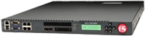
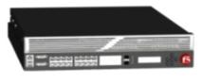
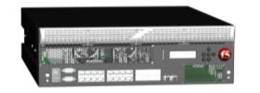
BIG-IP Platforms: Appliances
Model | 1600 | 3600 | 3900 | 6900-S | 8950-S | 11050
Max L4 Throughput | 1gb | 2gb | 4gb | 6gb | 18gb | 36gb
L4 Connection Rate | 60k CPS | 115k CPS | 175k CPS | 220k CPS | 600k CPS | 900k CPS
Max L7 Throughput | 1gb | 2gb | 5gb | 6gb | 18gb | 36gb
Max HTTP Req/s | 100k | 135k | 400k | 600k | 1,800k | 2,700k
Max Connections | 4m | 4m | 8m | 8m | 8m | 16m
SSL 1k Certs | 5k TPS | 10k TPS | 15k TPS | 75k TPS | 112k TPS | 112k TPS
SSL 2k Certs | 1k TPS | 2k TPS | 3k TPS | 15k TPS | 22k TPS | 22k TPS

Slide 22
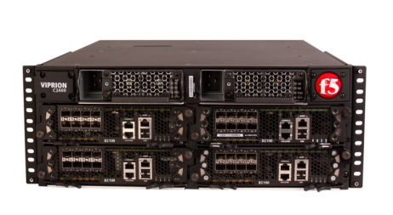
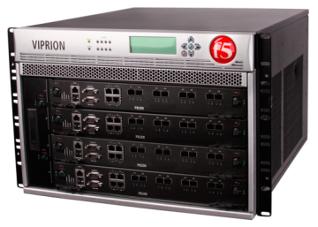
BIG-IP Platforms: Chassis
Model | VIPRION 2400 | VIPRION 4400
最大 4层吞吐 | 160 gb | 72 gb
4层连接速率 | 1,600k CPS | 2,800k CPS
最大7层吞吐 | 72 gb | 72 gb
最大HTTP每秒请求 | 4,000k RPS | 6,400k RPS
最大并发连接 | 64m | 64m
SSL 1k 证书 | 200k TPS | 200k TPS
SSL 2k 证书 | 40k TPS | 40k TPS
VIPRION 2400
VIPRION 4400
以上数字基于每机箱填充4个刀片
按需增容
添加新的刀片以增加容量
无需配置
第一、第二和未来的根刀片可以在同一个机架工作
支持vCMP 虚拟化
作为单一设备管理
多级冗余
内部刀片间切换
外部机架间切换
热插拔风扇，处理器刀片，电源和LCD
被动冗余背板
集成灯光输出管理

Slide 23

F5 LTM本地流量管理加速器

Slide 24
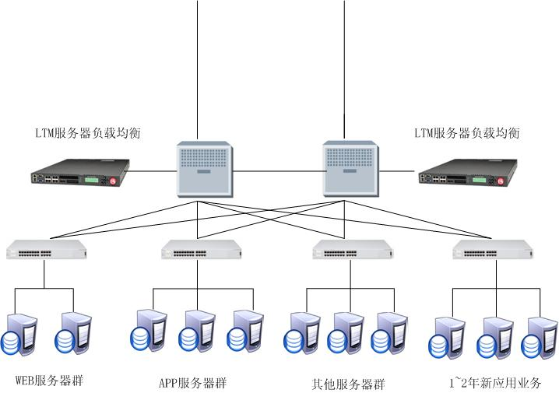
F5拓扑示意图

Slide 25
LTM功能介绍
多服务器负载均衡（标准配置）
SSL卸载功能（内置免费）
快速缓存功能（内置免费）
内容压缩功能（内置免费）
多连接复用功能（内置免费）
防DDOS攻击模块（内置免费）
速率限制模块（内置免费）
iRULE根据4-7层各种特征码进行流量控制（内置免费）
网络防火墙功能（内置免费）
SSL VPN功能（10个免费客户端）

Slide 26
F5 GTM数据中心负载均衡

Slide 27



城域网和广域网冗灾系统建设
互联网
www.F5.com
ISP1
ISP2
ISP3
ISP4
BIG-IP GTM
BIG-IP GTM
BIG-IP GTM
BIG-IP GTM
BIG-IP LTM/LC
BIG-IP LTM/LC
Application
Application
Application
Application
Enterprise Application
Enterprise Application

Slide 28
GTM功能介绍
多链路inbound负载均衡（内置免费）
多数据中心inbound负载均衡（内置免费）
完整DNS功能（内置免费）
GeoLocation地址库功能（内置免费）
DNS iRule功能（内置免费）
DNS缓存功能（单独激活）
DNS DDOS防护功能（单独激活）
DNS SEC安全功能（单独激活）

Slide 29
F5 LC多链路负载均衡

Slide 30
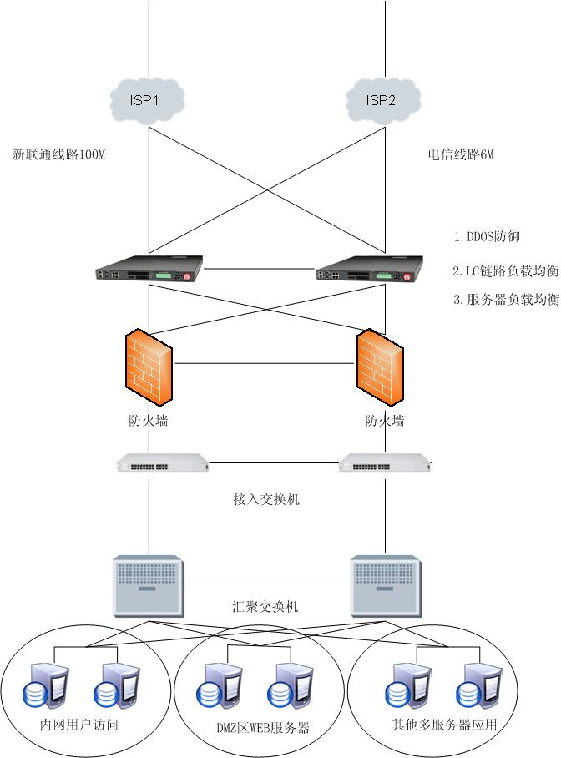

Slide 31
模块选型
多链路负载均衡
多服务器负载均衡（内置免费）
防DDOS攻击模块（内置免费）
速率限制模块（内置免费）
GeoLocation 地址库 （内置免费）

Slide 32
根据用户需求灵选线路
做到电信走电信，网通走网通加快用户响应速度
根据带宽比率来选择线路
根据不同的客户端来选择线路
给不同客户端限定速率完成带宽管理
给内部的各种应用服务进行带宽管理

Slide 33
F5 WA应用加速器

Slide 34
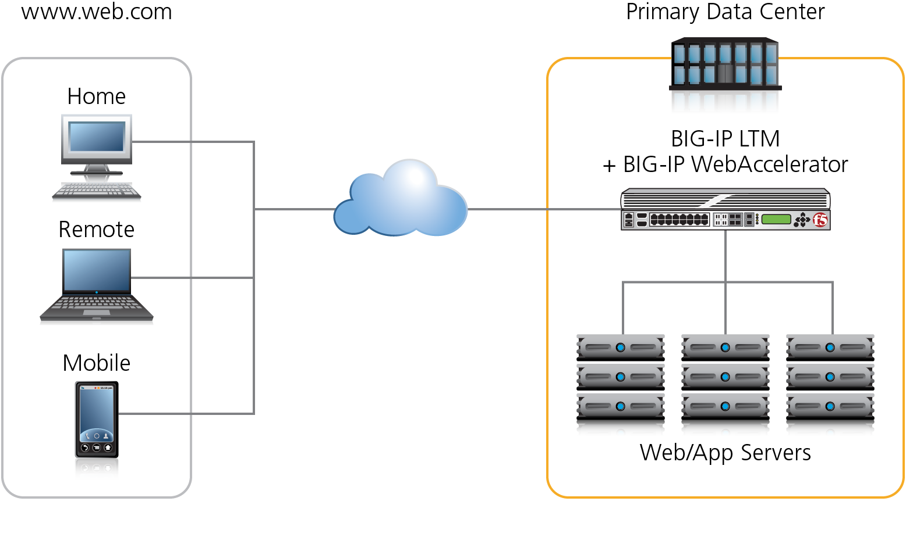

Increase Revenue and Productivity with BIG-IP WebAccelerator
BIG-IP WebAccelerator
Notes:
Market problem
- Customers will leave websites, abandon shopping carts, if the applications is too slow
Users are less productive because key (mission critical) web apps are not responsive
Why are apps slow?
Rich internet apps, increasing web page sizes
Huge number of requests per second
Accessing apps remotely, mobile users
Throughput and bandwidth challenges
Complex application environments – SOA, B2B XML/SOAP
Bad coding of Web-enabled applications combined with inappropriate protocols
Solution: BIG-IP WebAccelerator dramatically improves user experience by accelerating web application performance while achieving infrastructure efficiency and reducing costs.
Market Problem Detail:
There were a number all too common reasons why applications via the WAN are unusable.
Shifting from a client server app to a web based app because of the benefits that browsers based applications give
Web application need to be highly functional and feature rich… leading to a very fat web app (fat and fresh)
Increasing regulation forces companies to consolidate their servers in a need for greater control
Data Centers are consolidating
Users are more and more remote as companies’ workforces have become more global
Security and Authentication adds overhead
Chatty applications and protocols (CIFS and others)
Lack of bandwidth, high latency, congestion, and packet loss
Browser/platform/TCP stack incompatibility
Server latency – too busy serving same data over and over
Move to browser-based application interfaces
No coordination or planning between developers, server administrators and network architects
Bad coding of Web-enabled applications combined with inappropriate protocols
Centralization of branch office servers
XML and other rich content
Trends and Drivers info:
Massively integrated applications
Move from content to applications
Globalization & Outsourcing
Increased latency between users and applications
Server Consolidation
Increased load on servers
Increased prevalence of performance based SLAs
Page load times & Replication throughput
Financial penalties
Many legacy applications are being delivered over the web
Includes portals, CRM, collaboration, financials
SharePoint, Oracle Portal, Siebel, SAP, Plumtree, Hyperion
Lots of apps built on old code not intended for the business internet
Today's applications have radically changed the demands on the network.
Client Issue: How are changes in application and business environments affecting application performance?
Most businesses do not consider the implications of new Web-based applications during the planning and implementation stages. Many deployments suffer from poor performance due to the unique characteristics of Web-based application technologies. Network and server resources are thrown at the performance problem, only to find that the root cause cannot be addressed by looking at the individual bottlenecks. Through year-end 2007, businesses will deploy twice as many servers in their Web-enabled deployments than are required (0.8 probability). The reactive response to problems arising from business-class, Web-enabled applications is similar to what we observed during the migration of applications from a Systems Network Architecture (SNA) environment to client/server, routed-based architectures in the early 1990s. When characteristics of client/server applications and routed IP networks were better-understood, network designs addressed the key requirements and were deployed with significantly fewer problems. Other challenges also cause user performance issues. Many businesses are pushing to centralize distributed file and mail services. Although a major boost to operations, centralization comes at an expense. Responding with bandwidth (the usual response) does not solve many of the underlying problems. As we move toward more-complex, distributed user environments, user performance will continue to be a significant issue. Gartner
Past (Client/Server Era)
Distributed servers
100s TCP sessions/day
Clear text
Simple text presentation
Terse WAN protocol — TCP/IP
Today (Emerging Application Era)
Centralized servers (application, mail, file)
100s TCP sessions/second
SSL or IPsec encryption
Rich content (graphics, XML)
Chatty LAN protocols — CIFS, NFS, MAPI, HTTP(S)
Complex application environments – SOA, B2B XML/SOAP

Slide 35
WA功能
静态及动态页面缓存功能
内容压缩功能
内容缓存功能
多连接复用
TCP优化功能
WORD，PDF等文件加速功能
非对称加速功能

Slide 36

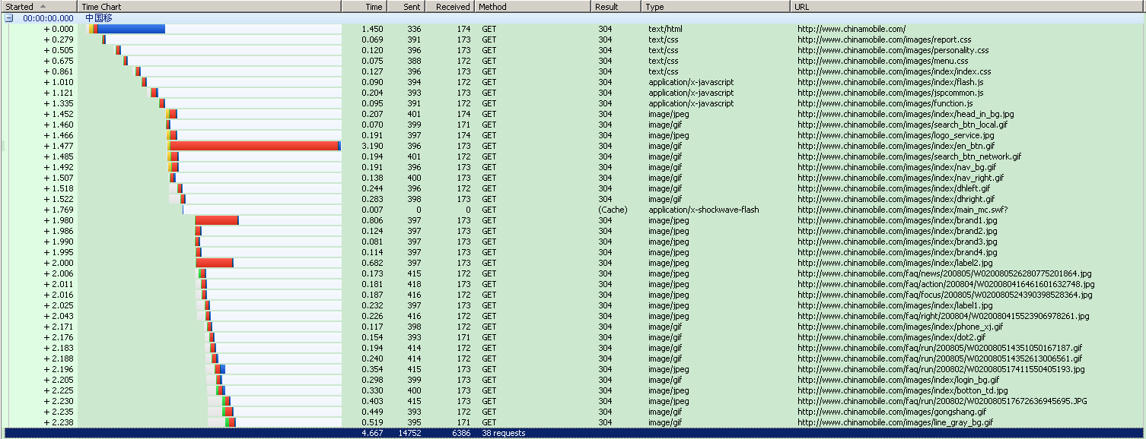
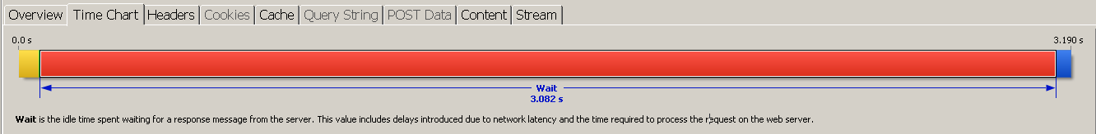
访问中国移动主页 http://www.chinamobile.com
用户等待时间4.667秒
一个小图片的内容更新确认让用户等待了3.190秒
Notes:
1.访问中国移动首页 click
2.用户打开页面用了共计4.667秒 click
3.用httpwatch分析，其中很多都只是询问browser中的内容是否过期 click
4.但其中一个内容影响了用户打开页面的速度。Click
5.一个小图片的过期确认等待让用户等待了3.190秒

Slide 37
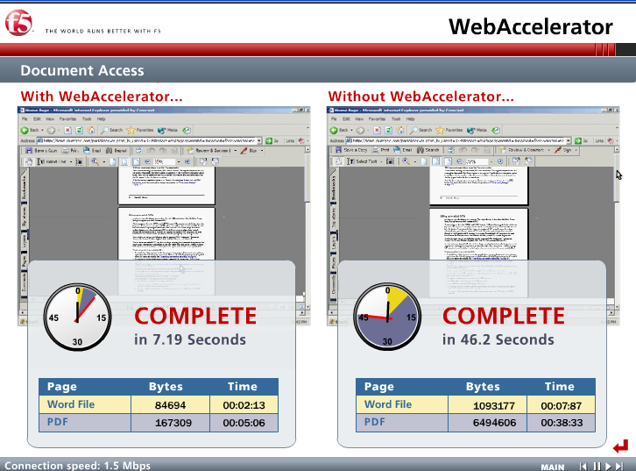
F5 WebAccelerator Centralized, Efficient Web Application Acceleration

Slide 38
Web Accelerator 加速效果
所有页面均为加密页面
22.2 Sec
Authentication
7.0 Sec
4.6 Sec
32.0 Sec
Welcome Page
5.3 Sec
5.2 Sec
No Acceleration
With the Web Accelerator
LAN Performance
19.8 Sec
Product Summary
6.9 Sec
3.0 Sec
29.2 Sec
Product Page
13.7 Sec
15.0 Sec
15.4 Sec
Search
12.5 Sec
8.8 Sec
69.9 Sec
PDF File
13.8 Sec
11.3 Sec
0.0 Sec
10.0 Sec
20.0 Sec
30.0 Sec
40.0 Sec
50.0 Sec
60.0 Sec
70.0 Sec
Notes:
客户-空中客车空中客车公司总部设在法国图卢兹
中国至法国的网络的连接

Slide 39
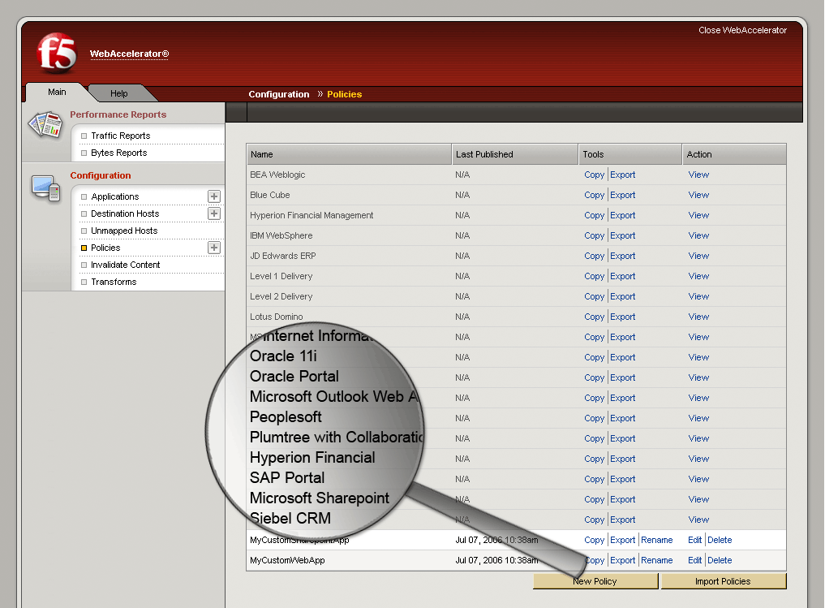








业界首个对Web应用进行打包、预配置和认证策略的优化设备
在应用厂商已经经过认证测试，并且已进行预先配置
Notes:
The WebAcclerator product offers the industry’s most advanced web application acceleration through F5’s unique Validated Web Application acceleration policies and Intelligent Browser Referencing technologies.
Validated Web Application acceleration policies offer specialized configuration options that have been certified, tested and proven to work effectively with web application platforms from Microsoft, Siebel, Oracle, and Plumtree/BEA Aqualogic. Additionally, the policies can act as built-in templates to enable enterprises to quickly customize WebAccelerator for their specific web applications.
“With WebAccelerator, F5 is the first vendor to deliver such extensive application specificity and offers ‘packaged intelligence’ for the application being deployed,” said Jason Needham, Director of Product Management at F5. “This capability enables our customers to improve their application acceleration results, handle application anomalies out-of-the box, and reduce the cost of deployment.”
“With its new release of WebAccelerator, F5 has taken some innovative steps in this market by offering unique capabilities that will help accelerate some of the more popular web applications. Enterprises can benefit from F5’s application specificity, comprehensive Application Delivery Networking portfolio, and unique TMOS architecture.” said Zeus Karravala, Vice President at the Yankee Group.
"A lot of companies offer application performance. But F5 offers application-specific solutions that are pre-configured for Oracle and other applications instead of making the enterprise customer figure out how to do it...by providing a generic solution for all applications," said Zeus Kerravala, an analyst at Yankee Group Research Inc. in Boston.

Slide 40
F5 APM远程接入管理

Slide 41
APM功能
SSL VPN功能
SSO功能
高级的端点安全功能
支持iPad, Driod, 移动终端和智能手机
简单，可视化的策略编辑器

Slide 42
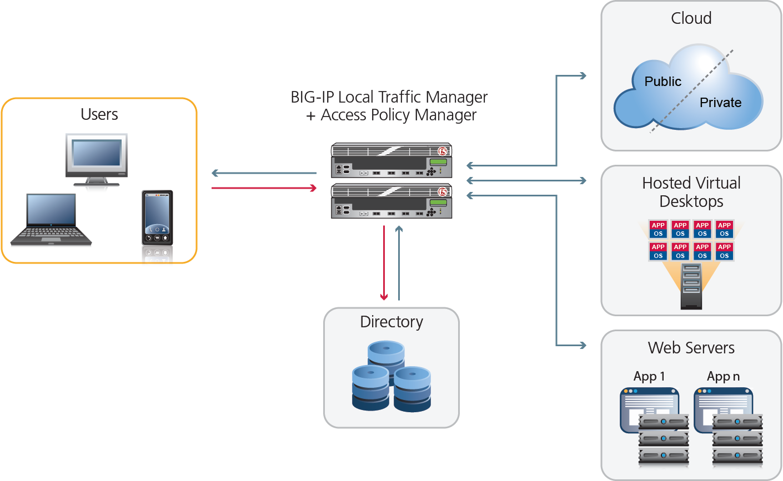

统一的应用访问 with BIG-IP Access Policy Manager (APM)
Notes:
BIG-IP APM = AAA control on BIG-IP
Integrates with AAA servers—including Active Directory, LDAP, RADIUS, and Native RSA SecurID

Slide 43


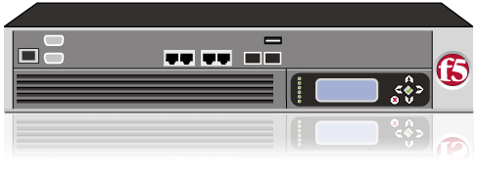
客户端安全－APM端点检查
– 指定的防病毒软件检查
－指定的个人防火墙检查
– Windows 操作系统补丁检查
– 注册表设置
－自带防病毒软件并可以通过ICAP与第三方防病毒软件联动
Access Policy Manager
Full
Network
Quarantine
Network
Please update
your machine!
通过APM，可以对每一个访问特定Virtual Server的客户端进行检查或者对每一个需要进行SSL VPN访问的客户端进行检查

Slide 44
F5 ASM应用安全防火墙

Slide 45








SSL封装的Web 攻击对防火墙/IPS和IDS来说是不可见的
Java
Employees
XML
.NET
web services
SOAP
LAN
J2EE
传统防火墙
只能防止网络攻击
Port 80/443 Web 流量畅通无阻
文件和打印服务
防火墙
IPS
IDS
WebDav Code Red
Nimda Forceful browsing
Cross site scripting OS command injection
Unicode attacks Cookie password theft
Cookie poisoning Web-based worms
SQL injection Site defacing
ATTACKS
Data Center
Web应用

Slide 46
当网络防火墙应用在Web上
SSL的问题。
网络入侵检测是设计工作在TCP/IP层的，在HTTP层并没有效果。
对内容检查的深度不够，且无法对内容进行任何操作。
数据伪装的问题。
因此，网络防火墙不适用于应用层的防护。

Slide 47
WEB应用攻击防护
操纵稳藏字段
更改Cookie
后门和调试漏洞
缓冲区溢出
输入信息控制
跨站点脚本
参数篡改
强制浏览
非法错误处理
Injection攻击
应用系统的默认配置

Slide 48
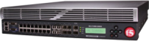

BIG-IP Application Security Manager 针对最新的网络威胁提供攻击防护
Injection Attack
Cross-Site Scripting (XSS)
Broken Authentication
Broken Session Management
Slow POST
Insecure Direct Object References
Slow Loris
Brute Force Attack
Cross-Site Request Forgery (CSRF)
SSL Renegotiation Vulnerabilities
Cross-Site Scripting (XSS)
Broken Authentication
Broken Session Management
Failure to Restrict URL Access
Insufficient Transport Layer Protection
Unvalidated Redirects and Forwards
Security Misconfiguration
Cookie Poisoning
Insecure Cryptographic Storage
Brute Force Attack
Cross-Site Request Forgery (CSRF)
SSL Renegotiation Vulnerabilities
Slow POST
Insecure Direct Object References
Slow Loris
Users
BIG-IP ASM
Web Applications
网络层安全防护
协议层安全防护（SMTP,HTTP,FTP）
应用层安全防护
针对所有web应用漏洞
记录全部应用流量的日志和报表
提供2-7层防护
PCI合规性
More

Slide 49
F5 WOM广域网加速器

Slide 50
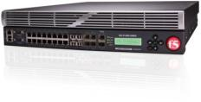
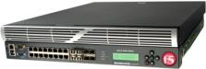
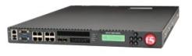
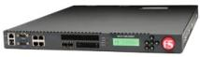
WOM支持的平台
$Price$
BIG-IP 8900
WOM Bundle SKU’s include max SSL & max compression
BIG-IP 6900
2 x Quad core CPU
16 10/100/1000 + 8x 1GB SFP
2x 320 GB HD (S/W RAID) + 8GB CF
16 GB memory
SSL @ 58K TPS / 9.6Gb bulk
6 Gbps max hardware compression
BIG-IP 3900
2 x Dual core CPU
16 10/100/1000 + 8x 1GB SFP
2x 320 GB HD (S/W RAID) + 8GB CF
8 GB memory
SSL @ 25K TPS / 4 Gb bulk
5 Gbps max hardware compression
BIG-IP 3600
Quad core CPU
8 10/100/1000 + 4x 1GB SFP
1x 300 GB HD + 8GB CF
8 GB memory
SSL @ 15K TPS / 3.8 Gb bulk
3.8 Gbps max software compression
WAN Optimized Throughput
10 Gbps
BIG-IP 1600
WAN Optimized Throughput
4 Gbps
Dual core CPU
8 10/100/1000 + 2x 1GB SFP
1x 160 GB HD + 8GB CF
4 GB memory
SSL @ 10K TPS / 2 Gb bulk
1 Gbps max software compression
Dual core CPU
4 10/100/1000 + 2x 1GB SFP
1x 160GB HD
SSL @ 5K TPS / 1 Gb Bulk
4 GB memory 1 Gbps max software compression
WAN Optimized Throughput
3 Gbps
WAN Optimized Throughput
1.5 Gbps
WAN Optimized Throughput
1 Gbps
Function / Performance

Slide 51


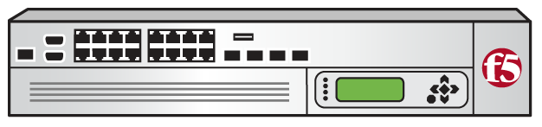
WOM总体介绍
原始
数据
BIG-IP LTM+ WOM
优化后的数据
iSessions
BIG-IP LTM+ WOM
Internet or WAN
原始
数据
Step 1
Step 2
Step 3
Step 4
Step 5
Step 6
应用协议加速
对称式
重复数据传输
对称式
智能压缩
SSL加密
TCP优化
带宽分配
优化后的数据
全功能WOM实现功能
LTM中包含的免费WOM模块

Slide 52
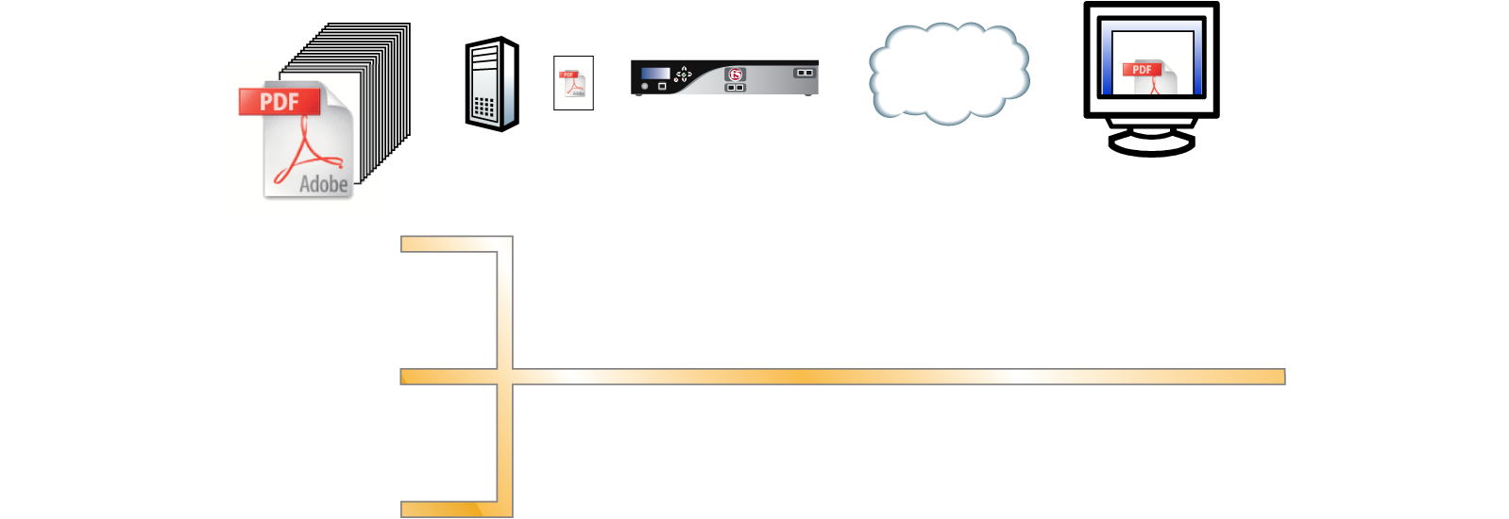
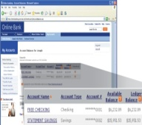
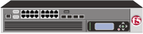







BIG-IP Wan Optimization Module 连接通过网络和应用代理、压缩和重复数据删除的方式被加密和加速
跨越广域网迁移工作中的VM镜像且不丢弃用户会话
加速诸如SnapMirror或Exchange的复制和备份
数据中心间的加速
Data Center 1
Data Center 2
BIG-IP
HTTP等应用的优化
TCP 和 HTTP 优化
Web Tier
Internet or WAN
BIG-IP
App Tier
数据复制和备份的优化.
BIG-IP / ARX
Active Database
File Servers
Standby Database
File Servers
Logical Diagram
More
This is a logical diagram. Database and storage acceleration will physically route through the BIG-IP.
Notes:
52

Slide 53
EDGE GATEWAY
包含WA、WOM和APM三个模块

Slide 54
EDGE Gateway的硬件平台
$Price$
BIG-IP 8900
WOM Bundle SKU’s include max SSL & max compression
BIG-IP 6900
2 x Quad core CPU
16 10/100/1000 + 8x 1GB SFP
2x 320 GB HD (S/W RAID) + 8GB CF
16 GB memory
SSL @ 58K TPS / 9.6Gb bulk
6 Gbps max hardware compression
BIG-IP 3900
2 x Dual core CPU
16 10/100/1000 + 8x 1GB SFP
2x 320 GB HD (S/W RAID) + 8GB CF
8 GB memory
SSL @ 25K TPS / 4 Gb bulk
5 Gbps max hardware compression
BIG-IP 3600
Quad core CPU
8 10/100/1000 + 4x 1GB SFP
1x 300 GB HD + 8GB CF
8 GB memory
SSL @ 15K TPS / 3.8 Gb bulk
3.8 Gbps max software compression
5000-40000并发用户
BIG-IP 1600
2500-25000并发用户
Dual core CPU
8 10/100/1000 + 2x 1GB SFP
1x 160 GB HD + 8GB CF
4 GB memory
SSL @ 10K TPS / 2 Gb bulk
1 Gbps max software compression
Dual core CPU
4 10/100/1000 + 2x 1GB SFP
1x 160GB HD
SSL @ 5K TPS / 1 Gb Bulk
4 GB memory 1 Gbps max software compression
1000-10000并发用户
500-5000并发用户
适用于大规模远程安全接入
有广泛分布的员工
或者全球各地分支机构
300-1000 并发用户
Function / Performance
54

Slide 55


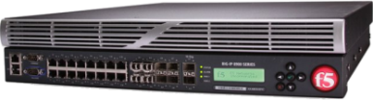
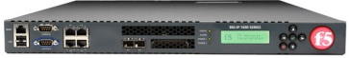

EDGE Gateway
BIG-IP Edge Gateway 包含了WA、WOM和APM三个模块
Clients
Applications
BIG-IP
Edge Gateway
BIG-IP
Edge Gateway
通过WA Module实现不对称加速
通过与远端WOM 配合实现对称加速
通过客户端软件实现客户端加速

Slide 56




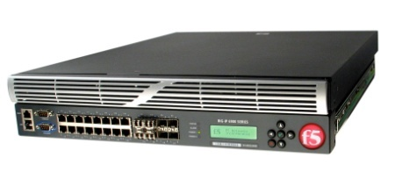

统一的数据中心接入管理
BIG-IP Edge Gateway
DMZ
Web Accl.
Access
Mobile Users
Internet
数据中心资源
WAN Opt.
Branch Office Users
Internal LAN
VLAN1
使用现有的用户权限管理系统
Wireless Users
Internal LAN
VLAN2
使用一个接入设备来管理所有的接入
提供足够的容量和性能来安全接入所有客户端
优化所有的远程和移动用户的接入
优化VOIP和流媒体的性能
LAN Users

Slide 57




更大的范围？
Primary
Data Center
BIG-IP Edge Gateway
Direct users to the Most optimal Edge Gateway
Remote User
BIG-IP GTM
BIG-IP Edge Gateway
Remote Office
Europe
BIG-IP LTM
Remote User
Remote user and office access to applications is SECURE and ACCELERATED
Remote Office
Japan
BIG-IP GTM
Remote User
BIG-IP Edge Gateway
BIG-IP Edge Gateway
Backup
Data Center
BIG-IP LTM

Slide 58
EM实现集中管理
Enterprise Manager

Slide 59



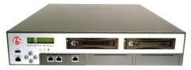
Enterprise Manager实现集中管理
New York Data Center
Dallas Data Center
Solution
Historical collection of application traffic statistics for trending and analysis
Capacity planning as well as trending and historical analysis
Opportunities to effectively plan with Business Units
IT Staff
IT Staff
IT Staff
IT Staff
IT Staff
IT Staff
IT Staff
IT Staff
Web
Web
SharePoint
Exchange
Web
SharePoint
Exchange
Accounting
ADC
ADC
ADC
ADC
ADC
ADC
ADC
ADC
Real-time
Monitors

Slide 60
Enterprise Manager的功能
独立软件，非软件模块
支持V9～V10版本，支持包括Viprion的所有硬件平台
针对单台设备或者设备分组
设备信息管理、License管理
软件版本/Hotfix管理
状态与性能监控、告警
配置管理：自动备份、配置修改和分发
iControl / iQuery实现，基于SSL通信

Slide 61

LTM VE
虚拟化支持

Slide 62
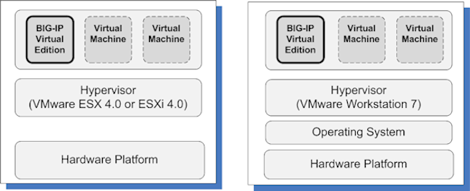
LTM VE-运行在虚拟机版本上的LTM
具有F5 LTM 10.1的全部功能（不包含GTM/WA/ASM等模块功能）
限制流量为1Mbps
提供90天的测试License，过期之后重新申请
目前提供为基于Vmware ESX/ESXi 4.0或

Slide 63
LTM VE 市场定位
免费版本可用于测试平台，减少测试机的使用，用户可以自行下载安装使用
正式版本可用于生产环境，在一台服务器上即可启用多台LTM
分部门管理不同的LTM
用于低流量平台，低成本平台等需求场合

Slide 64
Viprion平台

Slide 65
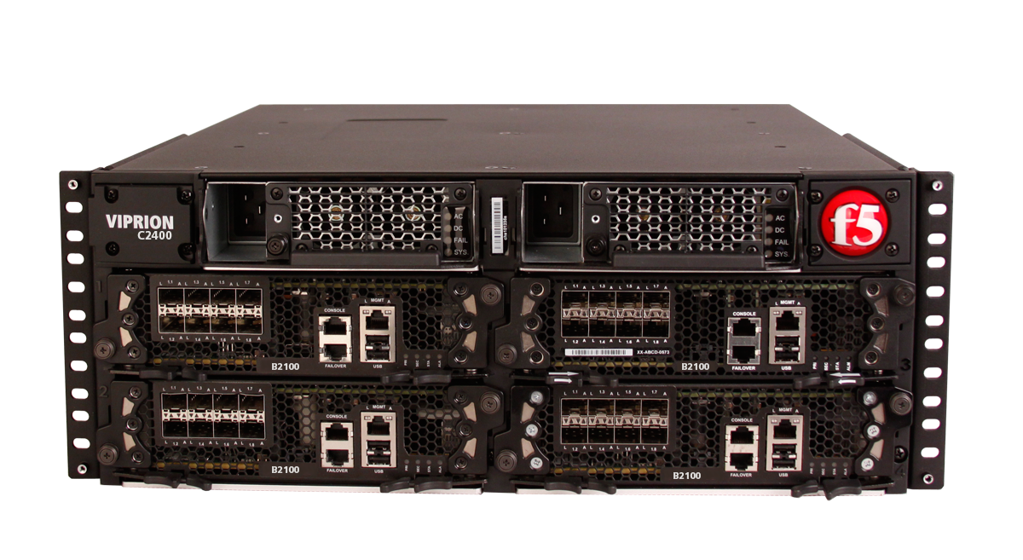
第9代
应用交付控制器
VIPRION 2400

Slide 66
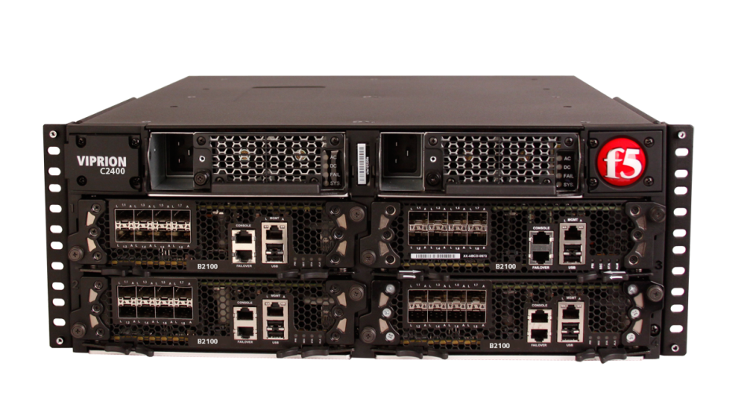
第9代应用交付控制器 VIPRION 2400
4Ｕ，4插卡，双冗余电源
模块化设计
全10G网络接口
10G ports (SFP+)
真正的节能减排
80 Plus-certified
Lowers TCO
4层专用芯片
ePVA+ High Speed Bridge

Slide 67
第9代应用交付控制器 VIPRION 2400
 | Single Blade | 4 Blade System
L7 Fast HTTP Inf/Inf | 1,000,000 rps | 4,000,000 rps
L7 Full Proxy | 150,000 cps | 600,000 cps
SSL TPS | 50,000 | 200,000
SSL Gbps | 9 Gbps | 36 Gbps
L4 Conn/s | 400,000 cps | 1,600,000 cps
Compression | 10 Gbps | 40 Gbps
L4 Throughput | 40 Gbps | 160 Gbps
L7 Throughput | 18 Gbps | 72 Gbps

Slide 68
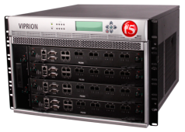
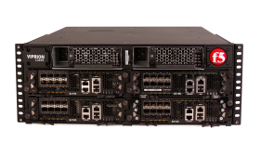


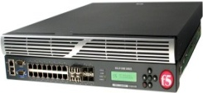
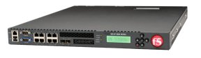

Platform Line-up
VIPRION 4400
VIPRION 2400
6.4M L7 RPS
2.8M L4 CPS
80G L7/L4 TPUT
VIPRION Chassis
4M L7 RPS
1.6M L4 CPS
80G/160G - L7/L4 TPUT
2.5M L7 RPS
1M L4 CPS
Up to 42G TPUT
1.2M L7 RPS
400K L4 CPS
Up to 20G TPUT
BIG-IP 11050
Application Switch
600k L7 RPS
220K L4 CPS
6G L7/L4 TPUT
BIG-IP 8900/8950
400k L7 RPS
175K L4 CPS
4G L7/L4 TPUT
BIG-IP 6900
135k L7 RPS
115K L4 CPS
2G L7/L4 TPUT
BIG-IP 3900
100k L7 RPS
60K L4 CPS
1G L7/L4 TPUT
BIG-IP 3600
BIG-IP 1600
Virtual Editions
Production
Lab
200 Mbps
1 Gbps

Slide 69


VIPRION 2400 企业级 – 按需扩展
为企业量身订做
4 插槽机箱
4 U 机架高度
10Gb (sfp+) 端口 – 每刀片8个
80 Plus certified power
性能
ePVA – 4层硬件卸载
40Gbps 硬件压缩
40000 2k key SSL TPS
安全和可靠
vCMP – 多实例的Big-IP
无源背板
标配双电源
虚拟化
(vCMP)
Notes:
High performance for acceleration
24Gbps L4/L7 throughput
16Gbps HW compression
100K SSL tps
High Throughput Replication Workloads and web applications
WOM and WA performance and scalability
Secure and Reliable
FIPS, SSL and IPSEC encryption
Dual power supplies and dual hard drives (RAID 1) standard
Front-to-back cooling

Slide 70



vCMP介绍
提供纵向扩展能力
F5提供创新的新型虚拟集群架构以支持应用交付服务的整合，该架构可提供按需扩展、更高的容错能力和改善的安全性。
Notes:
So what is vCMP? "Virtual Clustered Multiprocessing" is F5's unique capability to extend virtualization concepts to the BIG-IP platform.
PHOTOS of 2400 and 4400

Slide 71




Introducing the BIG-IP 11000 最大的加速性能
高性能加速平台
48Gb 内存
可选的 4倍固态硬盘 (SSD)
16Gbps 硬件压缩
100,000 SSL TPS
运行多个模块
在一台设备上运行多个模块和统一应用交付功能
安全和可靠
SSL 和 IPSec 加密
FIPS140-2 Level 2合规
标配双电源和双硬盘(RAID 1)标配双电源和双硬盘
Notes:
High performance for acceleration
24Gbps L4/L7 throughput
16Gbps HW compression
100K SSL tps
High Throughput Replication Workloads and web applications
WOM and WA performance and scalability
Secure and Reliable
FIPS, SSL and IPSEC encryption
Dual power supplies and dual hard drives (RAID 1) standard
Front-to-back cooling

Slide 72
全面的虚拟化支持
实例1
实例2
实例3
实例4
分区1
分区2
分区3
分区4
操作系统
操作系统
操作系统
操作系统
虚拟化
多租户
操作系统
硬件
硬件
特性 | 虚拟化 | 多租户
资源分配 | 静态的/专用的 | 灵活的 /共享的
操作系统 | 每个分区唯一的 | 共享的
Notes:
Build

Slide 73


问题： 众口难调
我现在不想升级
在整理财政报告期间不要维护
在季度结束期间不要维护
我想运行最新版本的BIG-IP
人力资源部门
财务部门
销售部门
网络部门
Notes:
Add security…

Slide 74


问题： 独立的设备
人力资源部门
财务部门
网络部门
销售部门

Slide 75


解决方案： 虚拟集群多处理（vCMP）
人力资源部门
财务部门
销售部门
网络部门
人力资源部门
财务部门
销售部门
网络部门
将不同部门、客户与子公司作为不同实例运行

Slide 76
解决方案： 虚拟集群多处理（vCMP）
管理维护窗口
运行不同版本的BIG-IP
人力资源部门
财务部门
销售部门
网络部门
人力资源部门
财务部门
销售部门
网络部门
BIG-IP v11.1
周六
19:00:00
星期五
03:00:00
BIG-IP v11
BIG-IP v11.1
周六
19:00:00
星期五
03:00:00
BIG-IP v11
BIG-IP v11.1
周六
19:00:00
星期五
03:00:00
BIG-IP v11
BIG-IP v11.1
周六
19:00:00
星期五
03:00:00
BIG-IP v11
将不同部门、客户与子公司作为不同实例运行

Slide 77
vCMP 使用案例
LTM 1
LTM 2
GTM
ASM
LTM 1
LTM 2
GTM
ASM
将不同模块作为实例运行——LTM、ASM与GTM 可以作为单独模块或模块组合来运行

Slide 78
Scaling BIG-IP via vCMP
Mixed Guest Allocation
Striped Guest Allocation
Blade 1
1
2
3
4
Blade 1
1
2
3
4
Blade 2
1
2
3
4
Blade 2
1
2
3
4
Blade 3
1
2
3
4
Blade 3
1
2
3
4
Blade 4
1
2
3
4
Blade 4
1
2
3
4
Single Guest Allocation
vCMP主要特点
访客可运行不同版本的操作系统
独立的访客升级
VIPRION的按需增容
隔离故障域
可基于multi-tenant功能
Blade 1
1
2
3
4
Blade 2
1
2
3
4
Blade 3
1
2
3
4
Blade 4
1
2
3
4

Slide 79








动态服务平台化的最佳选择
Customers & Employees
Employees
Secure & Optimized Cloud Connections
(F5 iSessions)
F5 Application
Delivery Controller
BIG-IP
Local
Traffic
Manager
BIG-IP
Local
Traffic
Manager
BIG-IP
Local
Traffic
Manager
BIG-IP
Local
Traffic
Manager
BIG-IP
Local
Traffic
Manager
BIG-IP
Local
Traffic
Manager
BIG-IP
Local
Traffic
Manager
BIG-IP
Local
Traffic
Manager
Internal Cloud
External Cloud
Internal Cloud

Slide 80












F5 构建动态服务平台
用户
应用与数据交付网络
可用性
扩展
HA / DR
突发
负载均衡
优化
网络
应用
存储
卸载
安全性
网络
应用
数据
接入
管理
集成
可见性
协调
控制
动态
资源
APP
APP
APP
APP
OS
OS
OS
OS
私有
APP
APP
APP
APP
OS
OS
OS
OS
公共
物理
虚拟
多站点数据中心
云
Notes:
That gives enterprises the Strategic points of control in application network infrastructure.

Slide 81



按需扩容, Zero Reconfig
Servers
Virtual Machines
Servers
热插拔电源模块
热插拔刀片板
线性增加应用交付能力
避免资源浪费
可视化的运营成本
Virtual Machines
Servers
Notes:
81

Slide 82

纵向扩展：CMP （Clustered MultiProcessing） – 提供线性的性能扩展
TMOS
Processing Resources
8x
Performance
4x
SMP
2x
Single
Processor
Time
Notes:
82

Slide 83


VIPRION 2400 为杰出而设计
TMOS
Processing Resources
8x
Performance
4x
SMP
2x
Single
Processor
Time
80 Plus-certified
Lowers TCO
ePVA Layer 4 offload + High Speed Bridge
Increases throughput by offloading L4 processing to this specially designed chip.
Hardware Compression
10Gbps/module
8x10G ports (SFP+)
Mid-size (4U) 4 slot blade chassis

Slide 84

vCMP + VIPRION
VIPRION与vCMP的独特之处在于可通过向机箱简单添加一个额外的刀片而支持按需扩容。
按 需 扩 展
=
+

Slide 85

按需扩展
Exchange
电子商务
人力资源应用
Oracle
SharePoint
资源——CPU、SSL卸载与压缩自动地添加到实例中
额外资源可供使用

Slide 86
vCMP架构
BIG-IP客户机以虚拟机方式运行
管理员选择客户机是在一个刀片上运行还是在所有刀片上运行
管理员将虚拟局域网分配给每个客户机
系统自动供应
CPU
内存
虚拟磁盘
VM₀
VM_{n}
客户机
TMOS
客户机
TMOS
VCMP 客户机的HAL（硬件抽象层 ）
VCMP 客户机的HAL
TMM 设备 驱动程序
TMM 设备 驱动程序
硬件队列
硬件队列
分配的物理和虚拟设备

Slide 87

资源分离
每位客户机都有专用的
CPU
内存
虚拟磁盘
所有客户机共享
SSL 硬件
压缩硬件
背板

Slide 88


Route Domains
具有可控性的合并
在一个BIG-IP上运行多个组且没有冲突
Route domains可以有共享的或独立的网关
支持重叠的IP地址：10.0.0.1可以在多个RD中存在
两个RD, 分别使用不同的网关
两个RD, 使用一个共享网关

Slide 89






数据中心防火墙
ASM
Protocol attack
L7 attack
Application DDoS
SMTP,FTP,FTPS
Web App Firewall
Secure
IP ANYCast
Full Proxy
Syn cookie
Portlocaldown
Packet filter
SSL Offload
iRules
……..
Network DDoS
DNS DDOS
LTM
DNS Express
GTM
L4 attack
DNS DDOS
DNS Security
High Speed Log
DNS Sec
APM
Web Access
Management
DNS falsification
EndPoint Check
L4-7 layer ACL
SSL VPN
Branch Office Users
Mobile Users
Mobile Users

Slide 90























F5与企业解决方案一览
F5 TMOS
分支机构
BIG-IP
WebAccelerator
Enterprise Manager
BIG-IP
Link Controller
移动用户
DMZ
FirePass
Firewalls
BIG-IP
Global Traffic Manager
Internet or WAN
BIG-IP
Application Security
Manager
BIG-IP
Local Traffic Manager
BIG-IP
Link Controller
灾备数据中心
DMZ
BIG-IP
WebAccelerator
FirePass
Firewalls
BIG-IP
Global Traffic Manager
OFM, 10gAS Portal
EBS
Psft
Siebel
RAC
BIG-IP
Local Traffic Manager
F5 TMOS
总部生产数据中心
Oracle Portal
Oracle E-Business Suite Applications
RAC
F5 TMOS

Slide 91



交付为目标的统一交付架构

Slide 92

双活数据中心

Slide 93



世纪佳缘网络拓扑
雍和宫移动机房
BIG-IP GTM
BIG-IP LTM 3900
BIG-IP LTM 3900
Application
Application
Enterprise Application
世纪互联B28
兆维机房
BIG-IP GTM
BIG-IP LTM 3900
BIG-IP GTM
BIG-IP LTM 3900
BIG-IP ASM
BIG-IP LTM 3900
BIG-IP LTM 3900
Application
Application
Application
Application
Enterprise Application
Enterprise Application

Slide 94
保险行业的特点和机会点
产险关键应用：
核心业务系统-车险及财产险
核心业务系统-人身险
核心业务系统-意外险
财务处理系统
核保核赔系统
业绩考核系统
单证管理系统
核保工作流
理赔工作流
中介管理系统
综合查询系统
报表系统
精算系统
LTM/ASM
LTM
LTM/ARX
LTM/LC/GTM

Slide 95

基于应用交付的ADN规划

Slide 96

核心业务应用体系

Slide 97

SSL VPN业务应用体系

Slide 98
卫生信息化系统
2003年 “非典”疫情暴露出信息不通、指挥不灵、公共卫生信息系统薄弱等问题之后，卫生部及时提出了《国家公共卫生信息系统建设方案》，促进了信息化工作的发展，信息化基础建设得到加强，建立了
全国疾病预防控制与突发公共卫生事件报告系统、
部（省）级应急指挥与决策信息系统、
卫生统计网络直报系统、
新型农村合作医疗信息系统、
医疗救治信息系统、
卫生执法监督等系统。

Slide 99
“3521”工程
--- 国家、省、地市县3级卫生信息平台
---公共卫生、医疗服务、医疗保障、药品监管和综合管理 5项业务应用
---居民电子健康档案、电子病历 2个基础数据库
---1个专用网络
Notes:
“十二五”期间卫生信息化发展的总体思路和任务
一是利用平台技术，联通纵向业务应用，实现统筹规划、资源整合，促进业务应用系统的互联互通和信息共享，从根本上消除“信息烟囱”、“信息孤岛”现象。
二是统筹完善业务应用系统，突出服务功能，共享各业务领域信息，优化流程，促进医疗质量提高、医疗费用降低，直接让人民群众受益。规范公共卫生信息的收集、整理、分析，增强政府公共卫生管理和科学决策能力。
三是以居民电子健康档案和电子病历数据资源库的标准化、规范化建设为重点，通过信息平台和业务系统的互联互通实现数据交换与业务协同以及对居民健康的动态管理。
四是以配备统一、规范的居民健康卡为突破口，促进互联互通，实现信息的有效交换，方便居民享受连续的预防、医疗、保健、康复等医疗卫生服务
卫生信息平台建设试点、居民电子健康档案和电子病历建设、居民健康卡建设等重点工作提出了明确的要求。

Slide 100


Slide 101

E-Medical Record Architecture
Notes:
服务器虚拟化 --Web、APP 、DB
ESB 企业服务总线 Web server SOAP 等

Slide 102


Slide 103


应用级容灾

Slide 104
广电城域网出口

Slide 105






传统出口链路解决方案
电信
联通
流量分发：
采用防火墙分发用户流量，无有效链路状态探测机制
链路中断直接影响用户访问，必须手工切换故障链路流量
直接影响用户满意度
线路扩展
手工调整流量分配
管理复杂
Router
Router
Router
Firewall
广电城域网用户
广电城域网用户

Slide 106
传统出口链路解决方案
电信
联通
流量分发：
采用防火墙分发用户流量，无有效链路状态探测机制
链路中断直接影响用户访问，必须手工切换故障链路流量
直接影响用户满意度
线路扩展
手工调整流量分配
管理复杂
Router
Router
Router
Firewall
广电城域网用户
广电城域网用户

Slide 107

F5解决方案主要特点
电信
联通
提升可用性
自动管理多条ISP链路
链路健康检查
自动切换故障链路
提升用户满意度
线路扩展
自动调整流量分配
轻松管理
Router
Router
Router
VIPRION
广电城域网用户
广电城域网用户

Slide 108
F5解决方案主要特点
电信
联通
降低运营成本
聚合多条低成本链路
使用多条1G链路聚合为10G链路
使用多条100M链路聚合为1G链路
提高现有带宽使用率
按带宽比例均衡分配流量
提高总体带宽的使用率
500M
500M
1G
Router
Router
Router
VIPRION
广电城域网用户
广电城域网用户

Slide 109
F5解决方案主要特点
电信
联通
提升应用的性能
根据客户地域或就近性选择链路，提升用户访问体验
TCP Express 和压缩提升用户的访问体验
Router
Router
Router
VIPRION
广电城域网用户
广电城域网用户

Slide 110

F5解决方案主要特点
投资保护
按需扩展的硬件平台
可随时增加服务器、防火墙负载均衡功能
支持IPv6

Slide 111


案例：湖北广电

Slide 112


案例：湖南广电
Internet or WAN
Router
Router
Router
1G
1G
1G
1G
1G
1G
10G
Firewall
10G
Router
广电用户

Slide 113
自动适应机顶盒

Slide 114



挑战
机顶盒种类繁多，性能高低不一，功能上存在差异
Portal应用服务器识别机顶盒，再做转发，性能压力大
用户体验差
同舟
ipanel
Enrich
other
WAN
Switch
同舟服务器群
iPanel服务器群
Enrich服务器群
其他

Slide 115

自动适应机顶盒
BIGIP自动识别机顶盒类型
智能分发到相应服务器群组
降低服务器负载
提升用户体验
同舟
ipanel
Enrich
other
WAN
BIG-IP Local Traffic Manager
Switch
同舟服务器群
iPanel服务器群
Enrich服务器群
其他

Slide 116











F5的解决方案
Hypervisor
广电网络
互动电视用户
媒资系统AMS
Hypervisor
BOSS系统
ScaleN集群
Hypervisor
Hypervisor
Hypervisor
第三方应用
后台管理系统
媒体服务平台

